Slide 1

Edge AI based Federated Learning Architecture for Healthcare Applications
BY
Harshitha Dondeti (2022BCS0209)
Madhav Murali (2022BCS0050)
Thadi Sushmitha Mani (2022BCD005)
Maddela Manoj (2022BCS0126)
Guided By,
Dr. Koppala Guravaiah

Slide 2
Project Updates
Baseline (previous work):
Implemented FedAvg on:
NIH Chest X-ray14 → 92.6% accuracy
MIT-BIH Arrhythmia → 94% accuracy
Validated feasibility of Federated Learning for healthcare (images + signals).
New in this work:
Added Synthetic Patient HealthCare Monitoring Dataset (tabular, 60K records).
Implemented FedProx and FedAdam for non-IID and fast-convergence scenarios.
Performed head-to-head comparison: FedAvg vs FedProx vs FedAdam.
Current Focus: How FedProx and FedAdam improve or complement FedAvg under different constraints.

Slide 3
Introduction
Current hospital systems:
- Use cloud-based AI with smart devices sending patient data (heart rate, oxygen levels, history) to servers. - Provides insights but has drawbacks.
Challenges: - Slow & bandwidth-heavy data transfer. - Privacy risks from centralized storage. - Compliance issues with HIPAA/GDPR and system differences.
Our solution: Edge AI + Federated Learning. - AI runs on local hospital devices, keeping data private. - Learns from patterns across hospitals without sharing raw data.
With Digital Twins - Virtual models of patients/systems. - Support personalized care, real-time monitoring, and smarter decisions.

Slide 4
Literature Review (Survey/Taxonomy Papers)
S.No | Paper with Author | Main Agenda | Limitations & Future Works
1. | Federated learning: a collaborative effort (Ng et al., 2021) | Proposed FL as a collaborative solution for hospitals with small datasets to build better AI models without sharing private patient data. | Highlights practical challenges like suboptimal model aggregation, hardware/software differences across sites, and lack of data standardization. Recommends developing better model aggregation strategies and standardized protocols
2. | Federated Learning for Smart Healthcare: A Survey (Nguyen et al., 2022) | Provide a comprehensive survey on applying FL in smart healthcare; cover architectures, applications, challenges, and enabling technologies. | Non-IID/unbalanced data, communication overhead, device heterogeneity, privacy risks, scalability.Lightweight & efficient FL models, stronger privacy (DP, HE, TEE), energy-aware methods, interoperability, standardization, cross-silo healthcare collaborations are some areas to look into.
Notes:
Privacy, Security & Compliance
HIPAA / GDPR issues – Privacy regulations, system mismatches.
DP (Differential Privacy) – Adds noise to protect individual data.
HE (Homomorphic Encryption) – Compute on encrypted data.
TEE (Trusted Execution Environment) – Hardware-based secure enclaves.
Privacy–accuracy trade-off – Strong privacy often reduces model performance.
Attacks –
Poisoning: Malicious updates.
Inference: Extracting sensitive data.
Adversarial manipulation: Crafted updates to mislead.

Slide 5
Literature Review (Survey/Taxonomy Papers)
S.No | Paper with Author | Main Agenda | Limitations & Future Works
3. | Federated Learning for Healthcare (Antunes et al., 2022 ACM TIST) (Survey + Research Proposal) | - Systematic review of FL in healthcare - propose EHR-based FL architecture | Non-IID data handling, privacy-accuracy trade-off, scalability, lack of standardization, security risks Improve Non-IID handling, add DP/HE/TEE, better scalability, privacy-preserving methods
4. | FL in Smart Healthcare (Cluster Computing) (Rahman et al., 2023) | Introduce FL for healthcare; taxonomy; apps in EHR, imaging, monitoring. | Non-IID data, privacy risks, weak datasets, IoMT limits. Blockchain + FL, data augmentation, XAI, hybrid/scalable FL.

Slide 6
Literature Review (Survey/Taxonomy Papers)
S.No | Paper with Author | Main Agenda | Limitations & Future Works
5. | FL for Medical Applications: Taxonomy (Rauniyar et al., 2023 IEEE IoT Journal) | Taxonomy of FL for medical apps: classify trends, challenges, and directions | High comms cost, security/privacy issues, resource constraints, interoperability gaps Explore lightweight FL, stronger privacy/security, multimodal FL, real clinical deployment
6. | FL for Healthcare Metaverse (Bashir et al., 2023 IEEE IoT Journal) | Apply FL in metaverse (VR/AR, IoMT, blockchain, digital twins). | Multimodal non-IID, resource/bandwidth limits, security, governance gaps. Lightweight FL for VR, DP/HE/TEE, blockchain trust, interoperability, energy efficiency.

Slide 7
Literature Review (Survey/Taxonomy Papers)
S.No | Paper with Author | Main Agenda | Limitations & Future Works
7. | Comprehensive Survey on Federated Learning (Reddy & Gadekallu, 2023) | Survey FL frameworks (FedAvg, FedHealth); healthcare apps in EHR, imaging, outbreak. | Privacy-accuracy trade-off, non-IID, trust, scalability, datasets. Transfer learning, efficient FL, adversarial defense, benchmark datasets.

Slide 8
Literature Review (Research Papers)
S.No | Paper with Author | Main Agenda | Limitations & Future Works
1. | Elayan et al., 2021 Sustainability of Healthcare Data Analysis IoT-Based Systems Using Deep FL | Proposes a privacy-preserving IoT healthcare architecture using deep FL with feedback-based local training and cloud sync | Limited edge compute, internet dependency, feedback reliance, biased data, slow learning, poisoned updates.
2. | Połap et al., 2021 Agent Architecture Based on FL and Blockchain | Multi-agent system integrating FL with blockchain for secure, scalable, and private medical systems. | High overhead, blockchain latency, complex maintenance, non-IID data challenge, scalability issues.

Slide 9
Literature Review (Research Papers)
S.No | Paper with Author | Main Agenda | Limitations & Future Works
3. | Edge-based Architecture for Healthcare Industry 4.0 (Pace et al., 2018) | Propose an edge-based computing architecture for efficient healthcare applications under Industry 4.0. | Limited scalability, energy constraints, integration with AI/FL not considered. Future Works: Incorporate FL/AI, scalability improvements, energy optimization, real-world validation.
4. | Federated learning for predicting clinical outcomes in patients with COVID-19 (Dayan et al., 2021) | Validated a global FL model (EXAM) across 20 sites for predicting COVID-19 outcomes, proving it outperformed locally trained models.. | Data inaccessibility and quality biases across unharmonized datasets.Requires prospective clinical validation and methods to assess client contribution.

Slide 10
Literature Review (Research Papers)
S.No | Paper with Author | Main Agenda | Limitations & Future Works
5. | Adoption of federated learning for healthcare informatics (Patel et al., 2022) | Discuss emerging applications of FL in healthcare informatics and analyze adoption potential with case studies. | Limited real-world deployment, interoperability issues, data heterogeneity, regulatory/policy challenges. Future Works: Standardization, FL framework optimization, cross-organization collaboration, stronger privacy/security mechanisms
6. | Digital Twins for Healthcare 4.0 (Alazab et al., 2022) | Review recent advances in digital twins applied to healthcare, including architectures and enabling technologies. | Lack of interoperability, scalability, data integration, and real-time reliability. Future Works: AI-enhanced DTs, secure data sharing, energy-efficient models, improved IoT/edge/cloud synergy.

Slide 11
Literature Review (Research Papers)
S.No | Paper with Author | Main Agenda | Limitations & Future Works
9. | Kapila & Saleti, 2025 FL-Based Disease Prediction with Feature Selection & Extraction | Fusion of FL and dimensionality reduction for accurate prediction on small health datasets. | Tested only in simulations, small datasets, lacks DP/HE, needs IoT scaling, Explainable AI, wider datasets.
10. | Haripriya et al., 2025 Privacy-Preserving FL for Collaborative Medical Data Mining | FL with CNNs (FedAvg/FedSGD) for medical image classification across hospitals while preserving privacy. | High resource usage, communication bottlenecks, poor hospital scalability, no multimodal support, privacy-accuracy trade-off.

Slide 12
Literature Review (Research Papers)
S.No | Paper with Author | Main Agenda | Limitations & Future Works
7. | Assessing the Impact of Federated Learning and Differential Privacy on Multi-centre Polyp Segmentation (Stelter et al., 2024) | Analyzed the performance trade-off of using Differential Privacy (DP) in both Centralized and Federated Learning for polyp segmentation. | Showed that DP significantly degrades model performance due to added noise, creating a privacy-accuracy trade-off. There is a need to explore novel privacy methods like GAN-based synthetic data generation.
8. | Review of Federated Learning and Machine Learning-Based Methods for Medical Image Analysis (Hernandez-Cruz et al., 2024) | Provided a comprehensive review and taxonomy of FL methods in medical image analysis, identifying non-IID data and privacy as key challenges. | Notes that the field's literature often makes unrealistic assumptions about data quality and infrastructure.The field needs more robust and practical solutions for handling real-world heterogeneous data.

Slide 13
Motivation
Handling Non-IID Data - All papers highlight that FL struggles with heterogeneous (Non-IID) data across hospitals and devices. - Current methods lack personalization, clustering, or adaptive aggregation to deal with this.
Balancing Privacy and Accuracy - Techniques like DP, HE, and TEE provide privacy but hurt accuracy or increase cost. - There is no widely adopted, efficient solution that ensures strong privacy without sacrificing performance.
Communication & Resource Constraints - FL requires frequent model updates, which is costly for IoT/wearable devices with limited bandwidth, memory, and battery. - Efficient model compression, lightweight training, and optimized protocols are still underexplored.
Notes:
Privacy, Security & Compliance
HIPAA / GDPR issues – Privacy regulations, system mismatches.
DP (Differential Privacy) – Adds noise to protect individual data.
HE (Homomorphic Encryption) – Compute on encrypted data.
TEE (Trusted Execution Environment) – Hardware-based secure enclaves.
Privacy–accuracy trade-off – Strong privacy often reduces model performance.
Attacks –
Poisoning: Malicious updates.
Inference: Extracting sensitive data.
Adversarial manipulation: Crafted updates to mislead.
Overheads – Frequent updates consume bandwidth.
Device heterogeneity – Different hardware/software.
Scalability issues – Expanding to many hospitals is complex.
IoMT limits – Low power, bandwidth, security on wearables/sensors.
Energy-aware methods – Optimize FL for battery-powered devices.
Model compression – Reduce model size to cut costs.

Slide 14
Motivation (Cont.)
Security & Robustness - FL remains vulnerable to poisoning attacks, inference attacks, and adversarial model manipulation. - More resilient architectures and built-in defense mechanisms are needed.
Scalability - Scaling FL across large, multi-institutional healthcare networks is challenging due to communication overhead and system coordination.
Standardization & Dataset Issues - Lack of standardized frameworks and interoperable healthcare data (EHR formats differ). - Few benchmark datasets → difficult to compare methods fairly. - Annotation scarcity in medical datasets limits supervised FL training.

Slide 15
Problem Statement:
The current cloud-based model for AI in healthcare is unsustainable. Centralizing patient data from IoT devices creates critical problems we aim to solve.
This approach leads to:
Severe Privacy Risks: A central server is a prime target for data breaches, exposing sensitive patient records.
Performance Issues: Constant data streaming causes high latency and bandwidth usage, which is unsuitable for real-time care.
Data Silos: Strict privacy laws and incompatible hospital systems prevent collaborative research, trapping valuable data.
Device Limitations: The model is too resource-intensive for the low-power IoT devices and wearables used in patient monitoring.
Our project addresses the urgent need for a decentralized system that allows hospitals to train AI models collaboratively, while keeping patient data secure, private, and local.

Slide 16
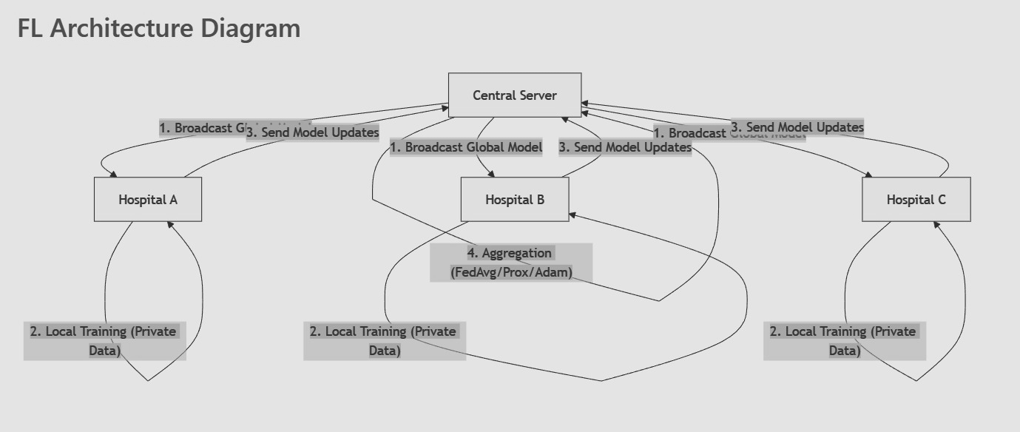
Implementation Architecture:

Slide 17
Overview: Approach to the Problem
Workflow
Data Acquisition
EHR data is transported and pre-processed
Local Training (Edge)
Labeled local data is used to train a Child Model. Inference errors are used to detect and correct mislabelled data.
Model Comparison & Deployment Child Model is compared with the Global Model: If better → Deployed If not → Global Model is used
Federated Learning Cycle Weights from local models are shared. A Global Model is updated and redistributed. Transfer Learning helps improve local models.
Continuous Feedback Loop Inferred results and mislabeled data are reused. Shadow models support tuning and experimentation.
Notes:
Objective: The proposed architecture aims to build a privacy-preserving, adaptive, and efficient Edge AI system for healthcare using federated learning, transfer learning, and digital twin integration. It ensures that models are trained locally on edge devices with Electronic Health Record (EHR) data, protecting patient privacy and allowing scalable, distributed model deployment and evaluation.

Slide 18
Datasets
NIH Chest X-ray14 → chest X-rays for pneumonia, lung disease.
https://www.kaggle.com/datasets/nih-chest-xrays/data
https://www.kaggle.com/datasets/khanfashee/nih-chest-x-ray-14-224x224-resized
PhysioNet Databases → physiological signals like ECG, EEG, vital signs.
https://physionet.org/about/database/
Synthetic Patient HealthCare Monitoring Dataset (new)

Slide 19
Previous Work Summary (FedAvg Baseline)
NIH Chest X-ray14 (Image-based FL):
112,120 chest X-rays, 14 disease labels, 3 simulated hospitals (non-IID).
FedAvg with CNN-LSTM; 5 rounds; achieved ≈92.6% accuracy.
MIT-BIH Arrhythmia (ECG FL):
10,729 beats, 3 nodes; CNN-BiLSTM; 3 rounds.
Global model reached 94% accuracy, matching centralized training.
Key observation: FedAvg works well for moderate non-IID in imaging and signal data, but:
Struggles with extreme client imbalance.
Converges slower when data heterogeneity is high. → Motivates trying FedProx and FedAdam.
Notes:
Objective: The proposed architecture aims to build a privacy-preserving, adaptive, and efficient Edge AI system for healthcare using federated learning, transfer learning, and digital twin integration. It ensures that models are trained locally on edge devices with Electronic Health Record (EHR) data, protecting patient privacy and allowing scalable, distributed model deployment and evaluation.

Slide 20
FedAvg - Implementation & Model Architecture
Dataset & Setup:
NIH Chest X-ray14
- 112,120 chest X-rays (224×224 RGB), 14 thoracic disease labels (multi-label)
MIT-BIH Arrhythmia
- 10,729 ECG beats from records 100-104, 1D segments of 360 samples
Data preprocessing & Non-IID splitting:
Chest X-ray: Resized to 224×224, normalized, split into 3 non-IID hospital clients using label-based shard allocation
ECG: Detrended, z-score normalized, segmented into 360-sample windows, split into 3 non-IID nodes

Slide 21
FedAvg - Implementation & Model Architecture (contd.)
Local client training (FedAvg):
• Chest X-ray:
- Model: CNN-LSTM (2 Conv + MaxPool → LSTM(128) → FC(64) → output(14, Sigmoid))
- 1 epoch/round, batch 32, Adam (1×10⁻⁴), Cross-Entropy loss
• ECG:
- Model: CNN-BiLSTM with Attention (3 Conv1D blocks → BiLSTM(64×2) + Attention → FC layers)
- 5 epochs/round, Adam (1×10⁻³) with LR scheduler, BCE/Focal Loss
Server aggregation (FedAvg):
• Central server aggregates model weights using Federated Averaging (weighted by local data size)
• Only model parameters exchanged; raw patient data stays local

Slide 22
FedAvg - Experimentation & Results
Chest X-ray14 (Image-based FL):
• 3 non-IID hospitals, 5 federated rounds
• Results:
– Validation accuracy: ≈92.2 - 92.6%
– Global CNN-LSTM converged stably
– FedAvg reduced impact of label imbalance across sites
MIT-BIH Arrhythmia (ECG FL):
• 3 non-IID nodes, 3 federated rounds
• Results:
– Global CNN-BiLSTM: ≈94% accuracy
– High precision/recall for abnormal beat detection
– Federated model matched centralized training performance

Slide 23
FedAvg - Experimentation & Results (contd.)
Key Observations (FedAvg Baseline):
• Federated learning viable for imaging and time-series healthcare data
• FedAvg handles moderate non-IID distributions well, preserves privacy
Limitations:
– Convergence slows under extreme client imbalance
– Motivates FedProx (stability) and FedAdam (speed)

Slide 24
Dataset 3: Synthetic Patient Monitoring
Why we added this dataset:
• Tests FL on tabular healthcare data (vitals + demographics)
• Simulates extreme non-IID scenario (9.4:1 client imbalance)
• Enables rapid experimentation with multiple FL algorithms
Dataset Details:
• 60,000 patient records, 9 features (Heart rate, SpO2, BP, Temp, Age, Gender, etc.)
• 5 disease classes: Asthma, Diabetes, Healthy, Heart Disease, Hypertension
• Non-IID split: 3 clients with extreme imbalance
- Client 1: 26,133 samples (43.6%)
- Client 2: 19,089 samples (31.8%)
- Client 3: 2,778 samples (4.6%)
- Imbalance ratio: 9.4:1 (largest to smallest)
• Challenge: Extreme heterogeneity tests algorithm robustness

Slide 25
Implementation using FedProx
Dataset: Synthetic Healthcare Monitoring Dataset (60,000 patients)
Target: Predicted Disease (Asthma, Diabetes, Healthy, Heart Disease, Hypertension)
Data preprocessing:
Missing value imputation
One-hot encoding for categorical data
Standard normalization (StandardScaler)
Removed leakage columns (alert signals derived from vitals)
Data distributed into 3 non-IID hospital clients using Dirichlet label skew
Each client trains locally using FedProx loss function
Server aggregates model updates using FedAvg

Slide 26
Model Architecture (FedProx)
Model Type: Tabular Deep Neural Network (MLP)
Input Layer: 9 normalized health features
Hidden Layer 1: 128 neurons, ReLU, Dropout(0.2)
Hidden Layer 2: 64 neurons, ReLU, Dropout(0.2)
Output Layer: 5 neurons (multi-class disease prediction)
Loss Function: Cross-Entropy
Optimizer: Adam (LR = 0.001)

Slide 27
Experimentation & Results using FedProx
Federated learning was conducted for 5 rounds, where each client performed 2 local training epochs per round. The system simulated 3 hospitals with non-IID patient distributions to reflect real-world healthcare data imbalance.
The final global model achieved an accuracy of 93.76%, with a macro F1 score of 0.9375 and micro F1 score of 0.9376, indicating strong and balanced disease prediction performance.
The model performed well across all five disease categories. The main classification confusion was observed between Asthma and Diabetes Mellitus, likely due to overlapping physiological indicators in the dataset.

Slide 28
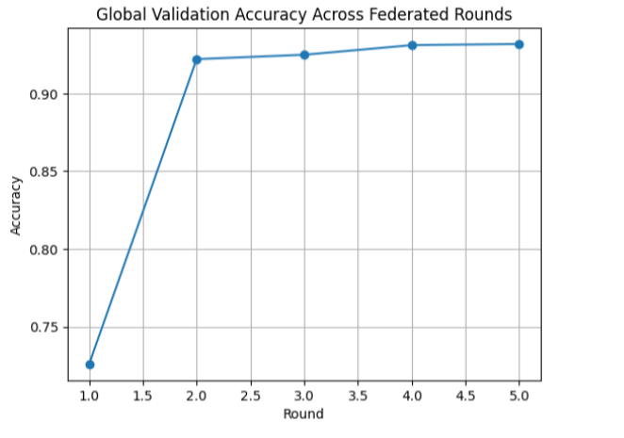
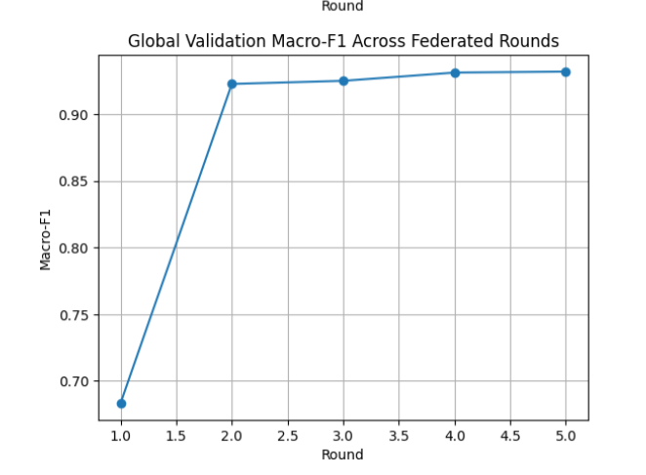
Experimentation & Results using FedProx

Slide 29
Outcomes using FedProx
FedProx stabilized training under heterogeneous client data
Reduced divergence of local client models
Adaptive model deployment (child model used only when better than global)
Achieved high predictive accuracy while preserving data privacy
Demonstrates practical federated AI system for healthcare

Slide 30
Implementation using FedAdam
Dataset download & filtering: ● Synthetic Patient Monitoring: 60,000 records, 13 features → filtered to 9 features (5 disease classes) ● Dropped leakage columns (alert features); normalized and one-hot encoded
Data preprocessing & Non-IID splitting: ● 5 non-IID clients simulating hospitals with varying data distributions ● Train-test split: 80-20 (48K train, 12K test)
Local client training: ● Simple MLP: Input(9) → Dense(128) → Dense(64) → Output(5) ● Optimizer: FedAdam (β₁=0.9, β₂=0.999) ● Loss: Cross-Entropy with class weighting
Server aggregation: ● FedAdam: Adaptive moment estimation at server (momentum + variance) ● 20 rounds, 5 clients per round, CUDA acceleration
Global evaluation: ● Test accuracy: 92.50% | Final loss: 0.2044

Slide 31
Model Architecture (FedAdam)
Simple MLP (3 Layers):
Input: 9 features (vitals + demographics)
Hidden 1: 128 neurons, ReLU, Dropout(0.3)
Hidden 2: 64 neurons, ReLU, Dropout(0.3)
Output: 5 classes (Softmax)
Training Config:
Optimizer: Adam (lr=1×10⁻³)
Loss: Cross-Entropy
Regularization: Dropout(0.3) + L2 decay
Total params: ~13,000

Slide 32
Experimentation & Results using FedAdam
Final Accuracy - 92.50%
Final Loss - 0.2044
Convergence - Round 3 (90% accuracy)
Key Observations:
Fastest convergence: 90% by round 3
Stable loss reduction: 1.5 → 0.2
Effective non-IID handling across 5 clients

Slide 33
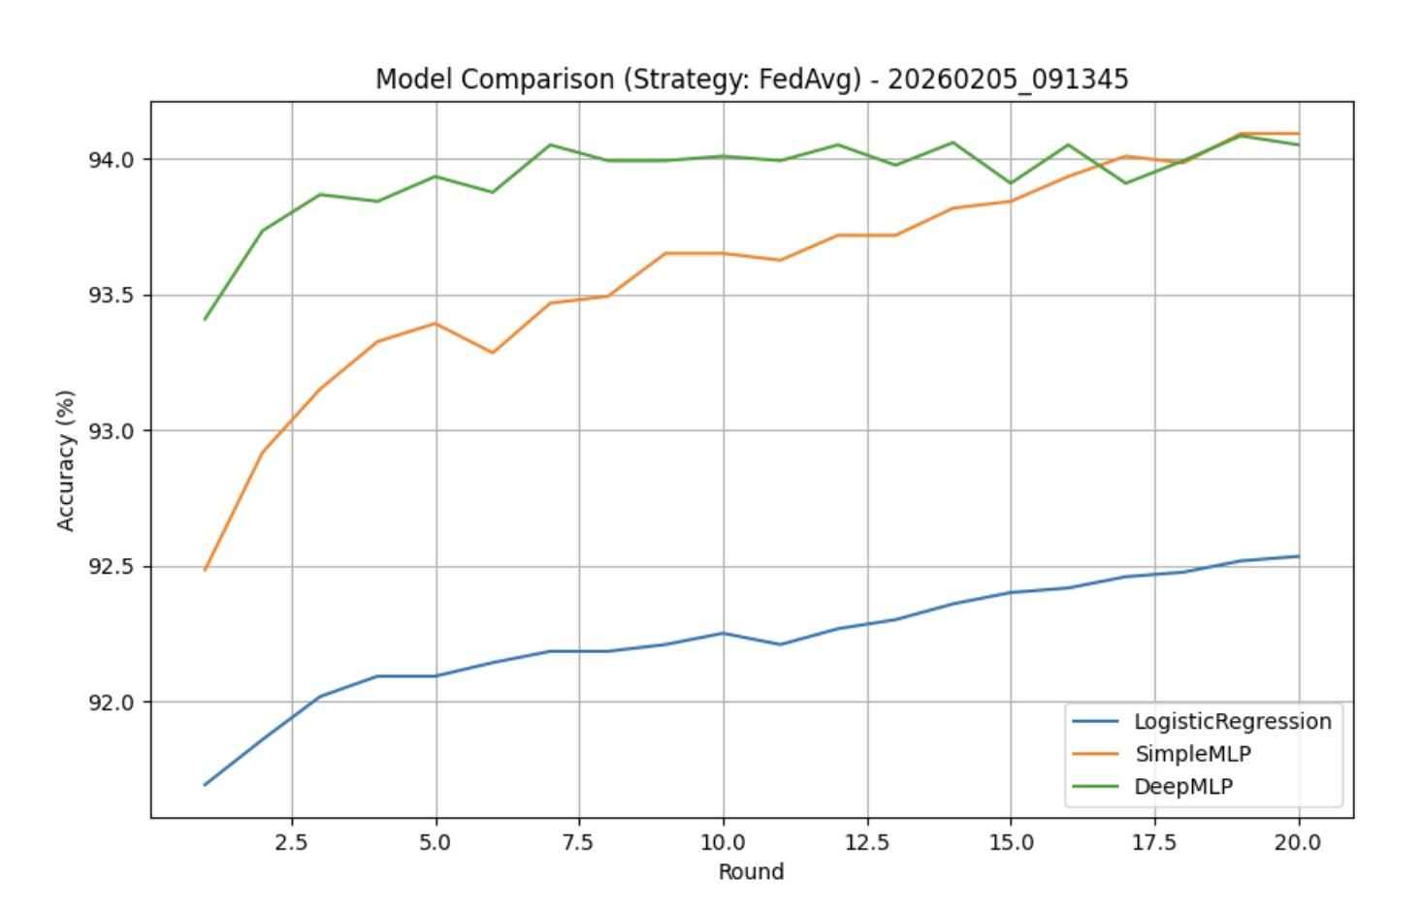
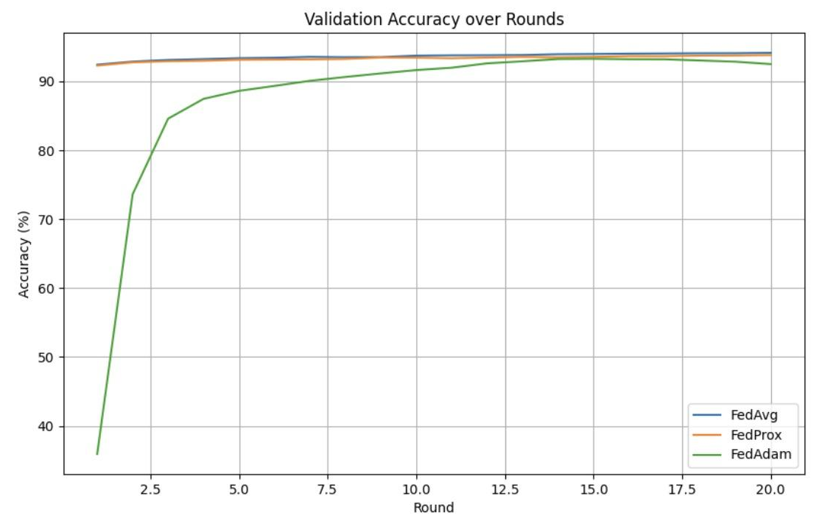
Experimentation & Results

Slide 34
Outcomes using FedAdam
Strengths: - Fastest convergence: Round 3 vs round 8-10 for others - Adaptive server-side learning (momentum + variance) - Edge-friendly: <1MB model size
Performance: ● 92.50% accuracy for 5-class disease prediction ● Rapid deployment capability (3 rounds to 90%) ● Suitable for time-constrained clinical scenarios

Slide 35
Comparison between all the methods
Metric | FedAvg | FedProx | FedAdam
Accuracy | 94.14% | 93.81% | 92.50%
Loss | 0.1473 | 0.1591 | 0.2044
Convergence | Round 10 | Round 8 | Round 3
Best for | General | Non-IID | Speed
Summary:
FedAvg: Highest accuracy (94.14%)
FedProx: Best for extreme heterogeneity (93.81% with 9.4:1 clients)
FedAdam: Fastest convergence (3 rounds to 90%+ accuracy)

Slide 36
Overall Insights:
Federated Learning works across modalities:
X-ray, ECG, and tabular patient data all achieved >92% accuracy without centralizing raw data.
Algorithm choice depends on deployment constraints:
FedAvg: Best overall accuracy and simplicity; good for balanced hospital networks.
FedProx: Preferred when hospital datasets are highly unbalanced or heterogeneous.
FedAdam: Ideal when we need a good model quickly (e.g., few rounds, time critical settings).
Non-IID data is the key challenge:
FedProx and FedAdam help address it in different ways (stability vs speed).
Edge feasibility:
Simple MLP (~13K params, <1MB) can run on hospital edge servers, enabling scalable deployment.
Privacy preserved by design:
Only model weights shared; patient data remains local, aligning with HIPAA/GDPR principles.

Slide 37
Demonstration
The system was implemented in Google Colab using PyTorch and KaggleHub datasets.
Federated learning workflow successfully simulated with three hospital clients.
Each client trained locally and contributed model weights to a central aggregator.
The global model was validated to ensure learning across all disease categories.
A sample of X-ray images with predicted disease labels was displayed as proof of model interpretability.
ECG waveform predictions for normal and abnormal beats were plotted to verify classification accuracy.

Slide 38
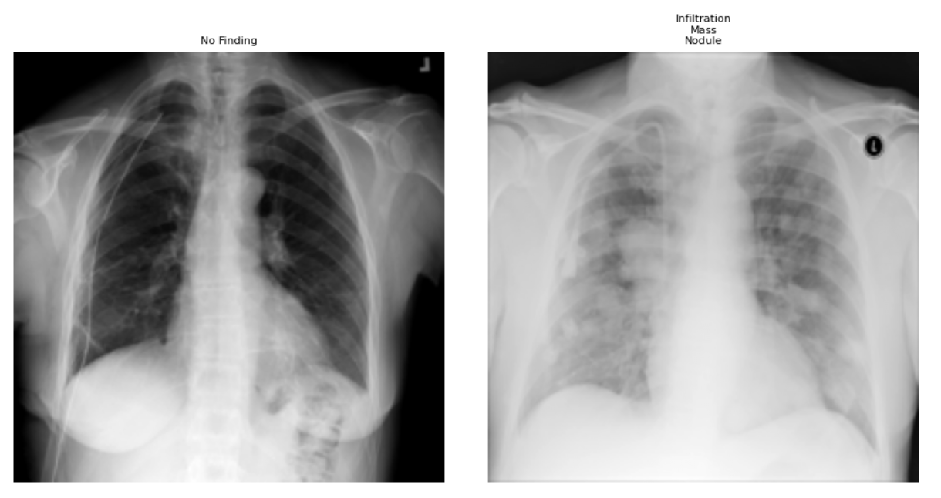
Indian Institute of Information Technology Kottayam
‹#›

Slide 39
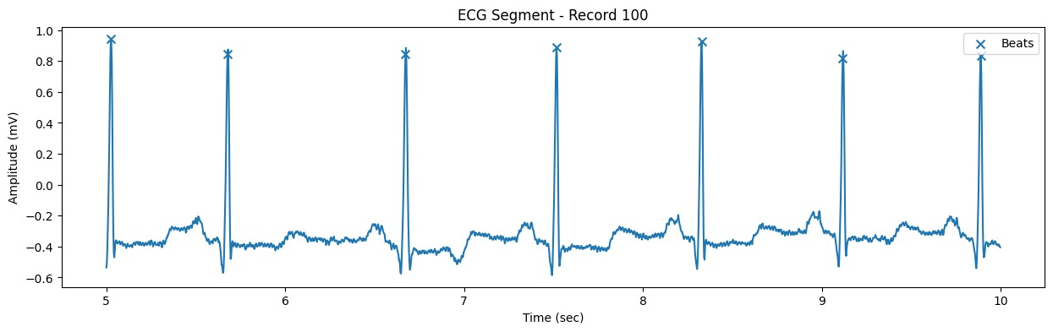

Slide 40
Future Work & Timeline
Model Tuning / Experiment Layer
Implement advanced FL optimizers (FedOpt – FedYogi)
Tune hyperparameters (rounds, learning rate, local epochs) for optimization.
Digital Twin Layer
Build a patient-level Digital Twin interface that simulates data flow between EHR → preprocessing → model inference → result.
Use synthetic or anonymized patient data for demo (not real PHI).
FHIR Integration
Add a small pipeline that converts local datasets into FHIR-compliant resources (Patient / Observation / Device).
This helps demonstrate real healthcare interoperability

Slide 41
References
Antunes, Rodolfo Stoffel, Cristiano André da Costa, Arne Küderle, Imrana Abdullahi Yari, and Björn Eskofier. "Federated learning for healthcare: Systematic review and architecture proposal." ACM Transactions on Intelligent Systems and Technology (TIST) 13, no. 4 (2022): 1-23.
Rauniyar, Ashish, Desta Haileselassie Hagos, Debesh Jha, Jan Erik Håkegård, Ulas Bagci, Danda B. Rawat, and Vladimir Vlassov. "Federated learning for medical applications: A taxonomy, current trends, challenges, and future research directions." IEEE Internet of Things Journal 11, no. 5 (2023): 7374-7398
.
Rahman, Anichur, Md Sazzad Hossain, Ghulam Muhammad, Dipanjali Kundu, Tanoy Debnath, Muaz Rahman, Md Saikat Islam Khan, Prayag Tiwari, and Shahab S. Band. "Federated learning-based AI approaches in smart healthcare: concepts, taxonomies, challenges and open issues." Cluster computing 26, no. 4 (2023): 2271-2311.
Dasaradharami Reddy, K., and Thippa Reddy Gadekallu. "A comprehensive survey on federated learning techniques for healthcare informatics." Computational Intelligence and Neuroscience 2023, no. 1 (2023): 8393990.
Bashir, Ali Kashif, Nancy Victor, Sweta Bhattacharya, Thien Huynh-The, Rajeswari Chengoden, Gokul Yenduri, Praveen Kumar Reddy Maddikunta, Quoc-Viet Pham, Thippa Reddy Gadekallu, and Madhusanka Liyanage. "Federated learning for the healthcare metaverse: Concepts, applications, challenges, and future directions." IEEE Internet of Things Journal 10, no. 24 (2023): 21873-21891.
Dayan, I., Roth, H.R., Zhong, A. et al. Federated learning for predicting clinical outcomes in patients with COVID-19. Nat Med 27, 1735–1743 (2021). https://doi.org/10.1038/s41591-021-01506-3
Ng, Dianwen, Xiang Lan, Melissa Min-Szu Yao, Wing P. Chan, & Meng ling Feng. "Federated learning: a collaborative effort to achieve better medical imaging models for individual sites that have small labelled datasets." Quantitative Imaging in Medicine and Surgery [Online], 11.2 (2021): 852-857
Stelter, Lena et al. “Assessing the Impact of Federated Learning and Differential Privacy on Multi-centre Polyp Segmentation.” Annual International Conference of the IEEE Engineering in Medicine and Biology Society. IEEE Engineering in Medicine and Biology Society. Annual International Conference vol. 2024 (2024): 1-4. doi:10.1109/EMBC53108.2024.10782682
Hernandez-Cruz, N.; Saha,P.; Sarker, M.M.K.; Noble, J.A. Review of Federated Learning and Machine Learning-Based Methods for Medical Image Analysis. Big Data Cogn.Comput. 2024, 8, 99. https://doi.org/10.3390/bdcc8090099

Slide 42
References
Elayan, Haya, Moayad Aloqaily, and Mohsen Guizani. "Sustainability of healthcare data analysis IoT based systems using deep federated learning." IEEE Internet of Things Journal 9, no. 10 (2021): 7338 7346Haripriya, Rahul, Nilay Khare, and Manish Pandey. "Privacy-preserving federated learning for collabora ve medical data mining in mul-ins tu onal se ngs." Scien fic Reports 15, no. 1 (2025): 12482.
Połap, Dawid, Gautam Srivastava, and Keping Yu. "Agent architecture of an intelligent medical system based on federated learning and blockchain technology." Journal of Informa on Security and Applica ons 58 (2021): 102748.
Kapila, Ramdas, and Sumalatha Sale . "Federated learning-based disease predic on: A fusion approach with feature selec on and extrac on." Biomedical Signal Processing and Control 100 (2025): 106961.
Nguyen, Dinh C., Quoc-Viet Pham, Pubudu N. Pathirana, Ming Ding, Aruna Seneviratne, Zihuai Lin, Octavia Dobre, and Won-Joo Hwang. "Federated learning for smart healthcare: A survey." ACM Computing Surveys (Csur) 55, no. 3 (2022): 1-37.
Patel, Vishwa Amitkumar, Pronaya Bhattacharya, Sudeep Tanwar, Rajesh Gupta, Gulshan Sharma, Pitshou N. Bokoro, and Ravi Sharma. "Adoption of federated learning for healthcare informatics: Emerging applications and future directions." IEEE Access 10 (2022): 90792-90826.
Alazab, Mamoun, Latif U. Khan, Srinivas Koppu, Swarna Priya Ramu, Parimala Boobalan, Thar Baker, Praveen Kumar Reddy Maddikunta, Thippa Reddy Gadekallu, and Ahamed Aljuhani. "Digital twins for healthcare 4.0—recent advances, architecture, and open challenges." IEEE Consumer Electronics Magazine 12, no. 6 (2022): 29-37.
Pace, Pasquale, Gianluca Aloi, Raffaele Gravina, Giuseppe Caliciuri, Giancarlo Fortino, and Antonio Liotta. "An edge-based architecture to support efficient applications for healthcare industry 4.0." IEEE Transactions on Industrial Informatics 15, no. 1 (2018): 481-489.

